Slide 1
OWL 2 Profiles: QL, EL, RL Ontology-based Data Integration
Jose Luis Ambite
University of Southern California

Slide 2
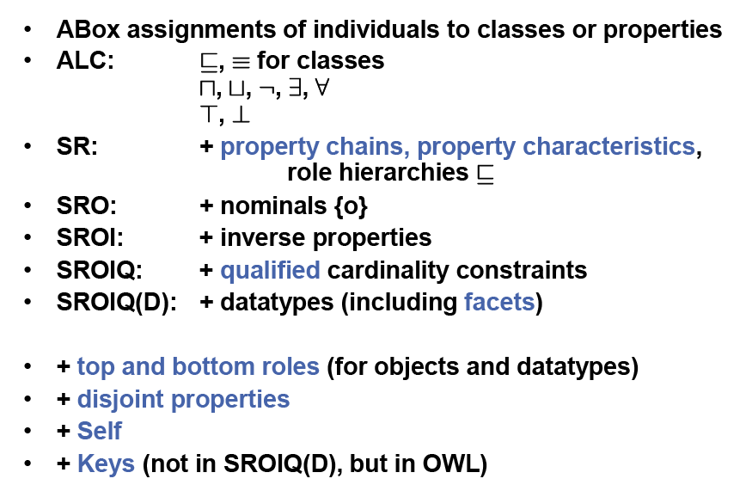
OWL2 DL: SROIQ(D)
based on slide from Pascal Hitzler

Slide 3
OWL2 Description Logic
OWL DL corresponds to a well-studied decidable description logic SROIQ(D)
2NExpTime-complete
Implemented reasoners: Fact++, Hermit, Pellet, RacerPro

Slide 4
OWL2 Description Logic
OWL DL corresponds to a well-studied decidable description logic SROIQ(D)
2NExpTime-complete (!!!)
Implemented reasoners: Fact++, Hermit, Pellet, RacerPro

Slide 5
OWL2 Profiles
OWL 2 defines three different tractable profiles:
QL: very fast (AC₀) query answering using RDBMs (SQL)
Useful for large datasets (stored in RDBs)
EL: fast (P) reasoning for schema and data
Useful for ontologies with large conceptual part
Ex: biomedical ontologies, O(10⁵) concepts
RL: fast (P) query answering using rule-extended DBs
Useful for large datasets stored as RDF triples
[based on slide from Ian Horrocks]

Slide 6
Complexity of Query Evaluation
[Vardi, 1982]
Query complexity: complexity of evaluating queries q over an arbitrary, but fixed, database D, q(D), as the size of the queries grow
Data complexity: complexity of evaluating an arbitrary, but fixed, query q over databases D, q(D), as the size of the databases grow.
Combined complexity: complexity of evaluating q(D) as both q and D grow.

Slide 7
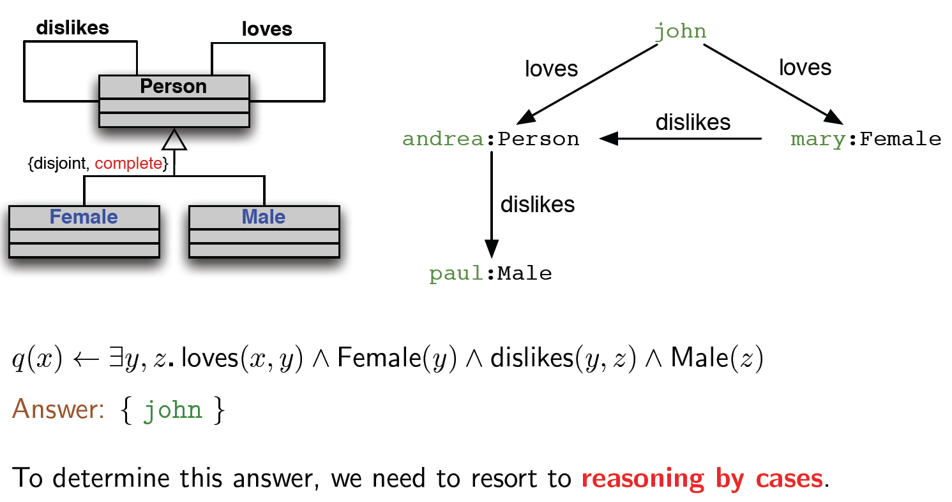
Query Answering in Ontologies
[based on slide from Diego Calvanese, on an example by Andrea Schaerf]

Slide 8
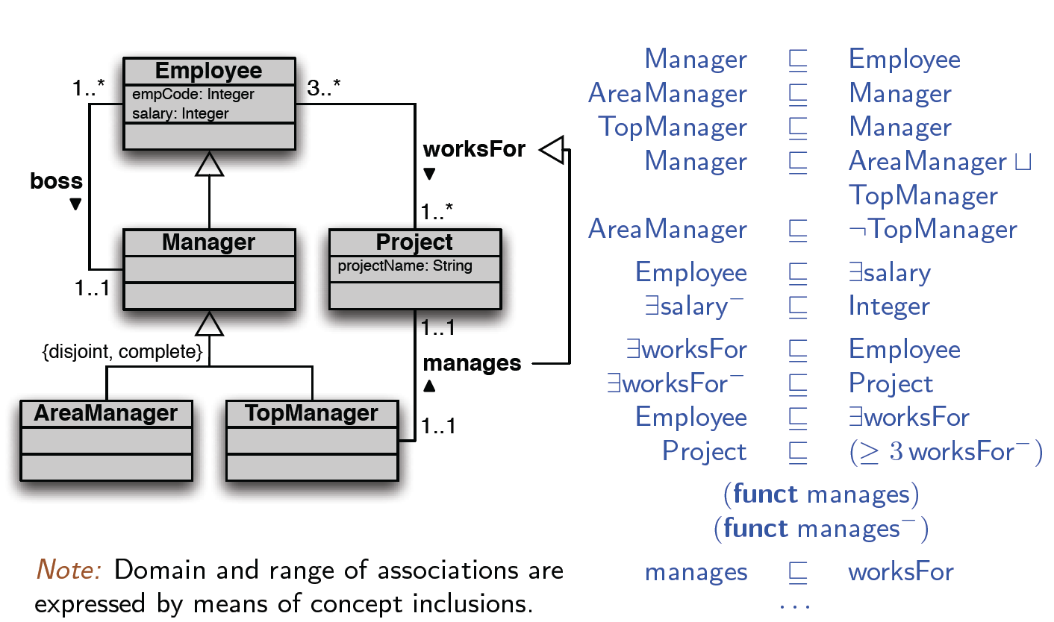
Encoding UML diagrams in Description Logics
[based on slide from Diego Calvanese]

Slide 9
OWL2 QL
OWL2 QL designed to query large datasets
Conjunctive queries using ontology concepts and relations
Efficient query answering by compiling ontology in query and evaluating SQL on relational DB
Polynomial complexity for standard DL reasoning tasks: consistency, subsumption, classification, …
Based on the DL-Lite family of description logics

Slide 10
OWL2 QL: Expressivity vs Complexity
Achieve efficiency by restricting expressivity:
Axioms impose different restrictions on subclasses and superclasses:
Subclasses: primitive classes, or unrestricted existentials
Superclasses: primitive classes, existentials or conjunctions with superclass filler (recursive), or negations with subclass filler
Property hierarchies, disjointness, inverses, (a)symmetry supported, restrictions on range and domain
Disjoint or equivalence of classes only for subclass expressions
No disjunctions, universals, Self, keys, nominals, equality, property chains, transitive properties, cardinalities, or functional properties
Ex: Chair ⊑ Professor ⨅ ∃headOf.Deparment ⨅ ¬ Emeritus
[based on slide from P. Hitzler, M. Kr.tzsch, S. Rudolph]

Slide 11
DL-Lite
Family of Description Logics
Goals:
keep reasoning tasks (subsumption, satisfiability, classification, instance checking) polynomial in the size of the T-box and AC⁰ in the size of the data
Keep conjunctive query answering in AC⁰ (rewrites to SQL!)
OWL2 QL is based on DL-Lite_{R}
We’ll cover DL-Lite_{A} which is more expressive (although it relies on UNA to keep complexity low)
Diego Calvanese, Giuseppe De Giacomo, Domenico Lembo, Maurizio Lenzerini, and Riccardo Rosati. Tractable reasoning and efficient query answering in description logics: The DL-Lite family. Journal of Automated Reasoning, 39(3):385-429, 2007.

Slide 12
Basic features of DL-Lite_{A}
DL-Lite_{A,id} is an expressive member of the DL-Lite family.
Covers (most of) UML and Extended Entity-Relationship models
Identification constraints ~ keys
Distinguishes objects and values:
Objects are elements of an abstract interpretation domain.
Values are elements of concrete data types, such as integers, strings ...
Values are connected to objects through attributes (rather than roles)
[In OWL2: object properties (roles) vs data properties (atttributes)]
Enjoys FOL-rewritability, and hence is AC₀ in data complexity
i.e., queries can be rewritten to relational algebra/calculus (SQL!)
[based on slide by Diego Calvanese]

Slide 13
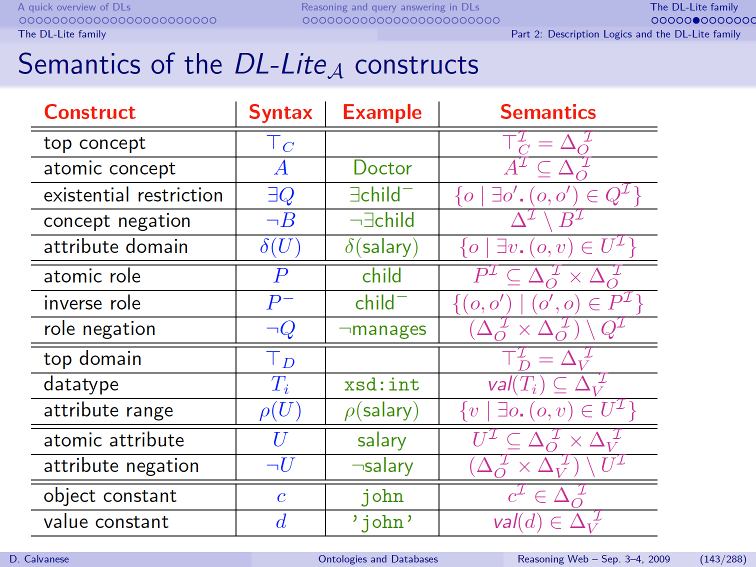

Slide 14
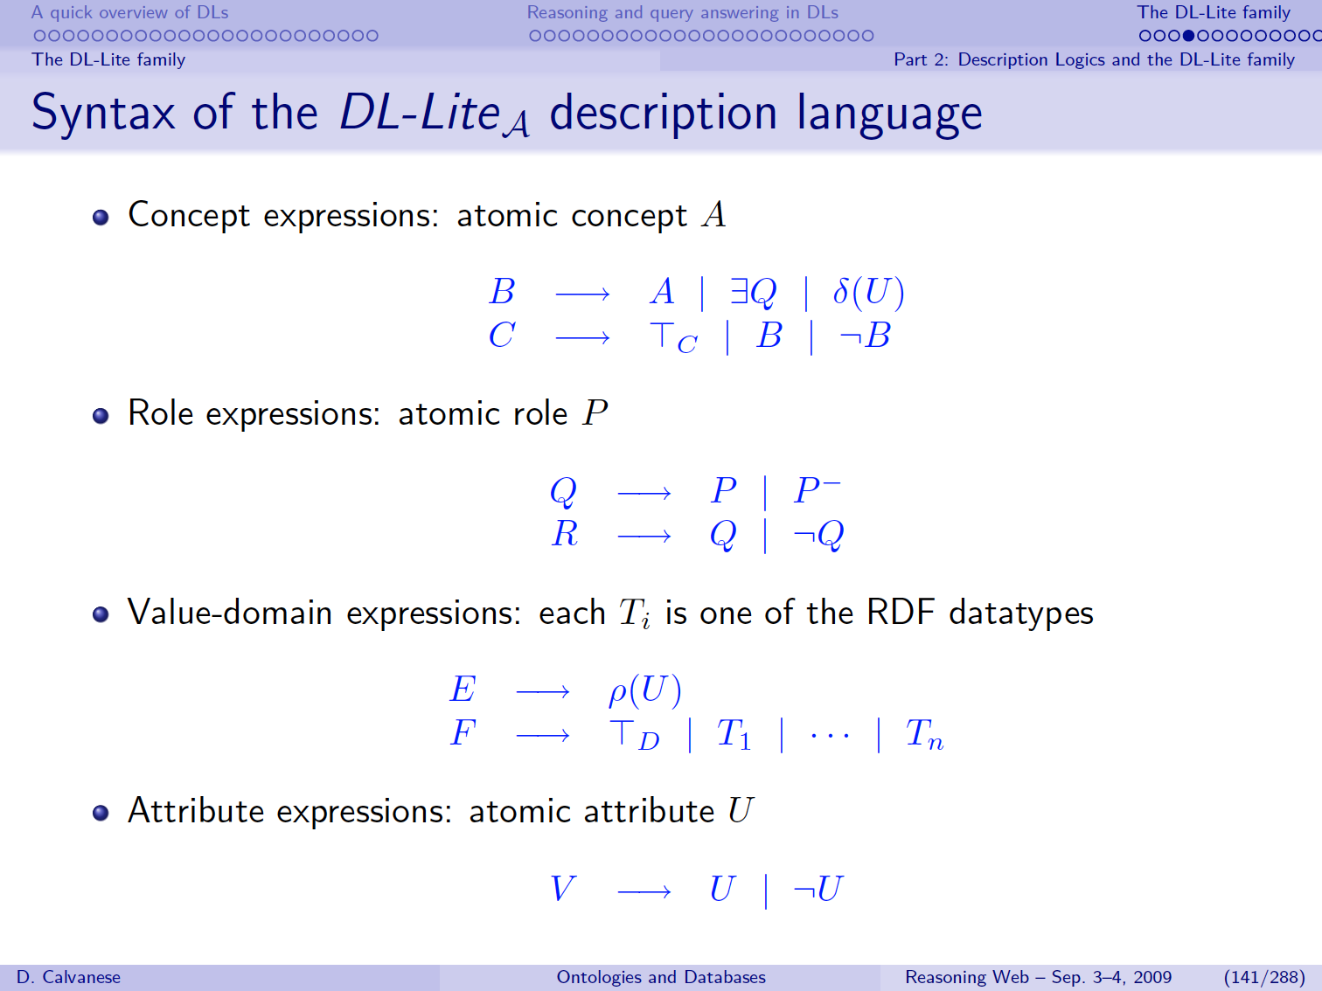

Slide 15
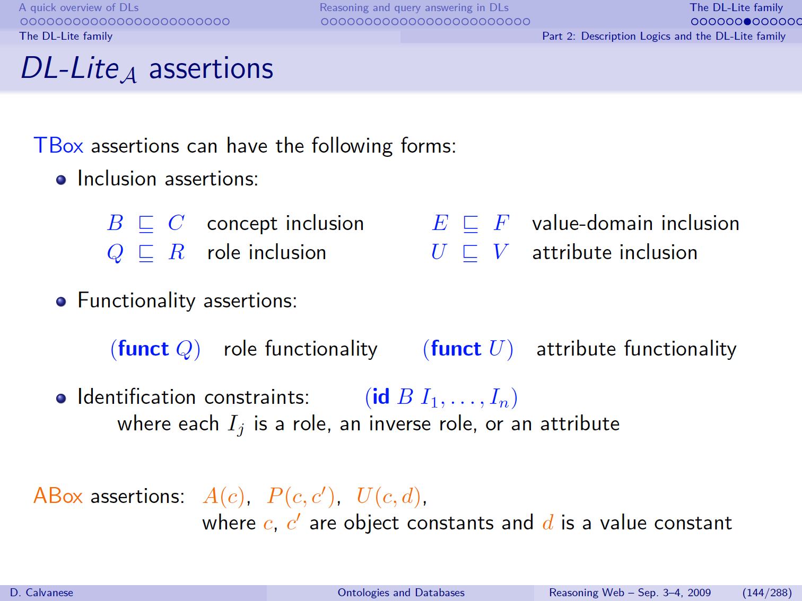

Slide 16
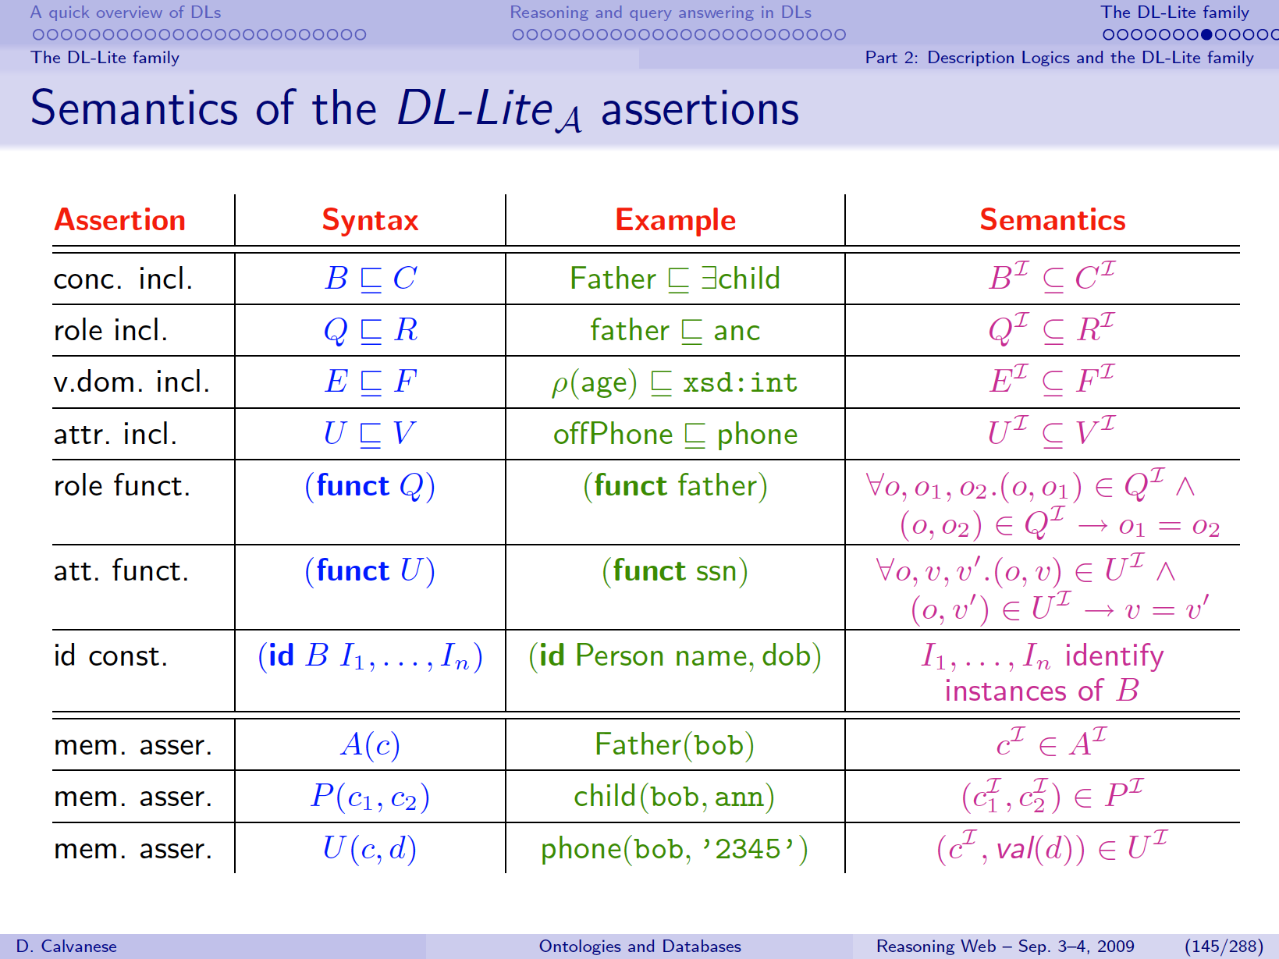

Slide 17
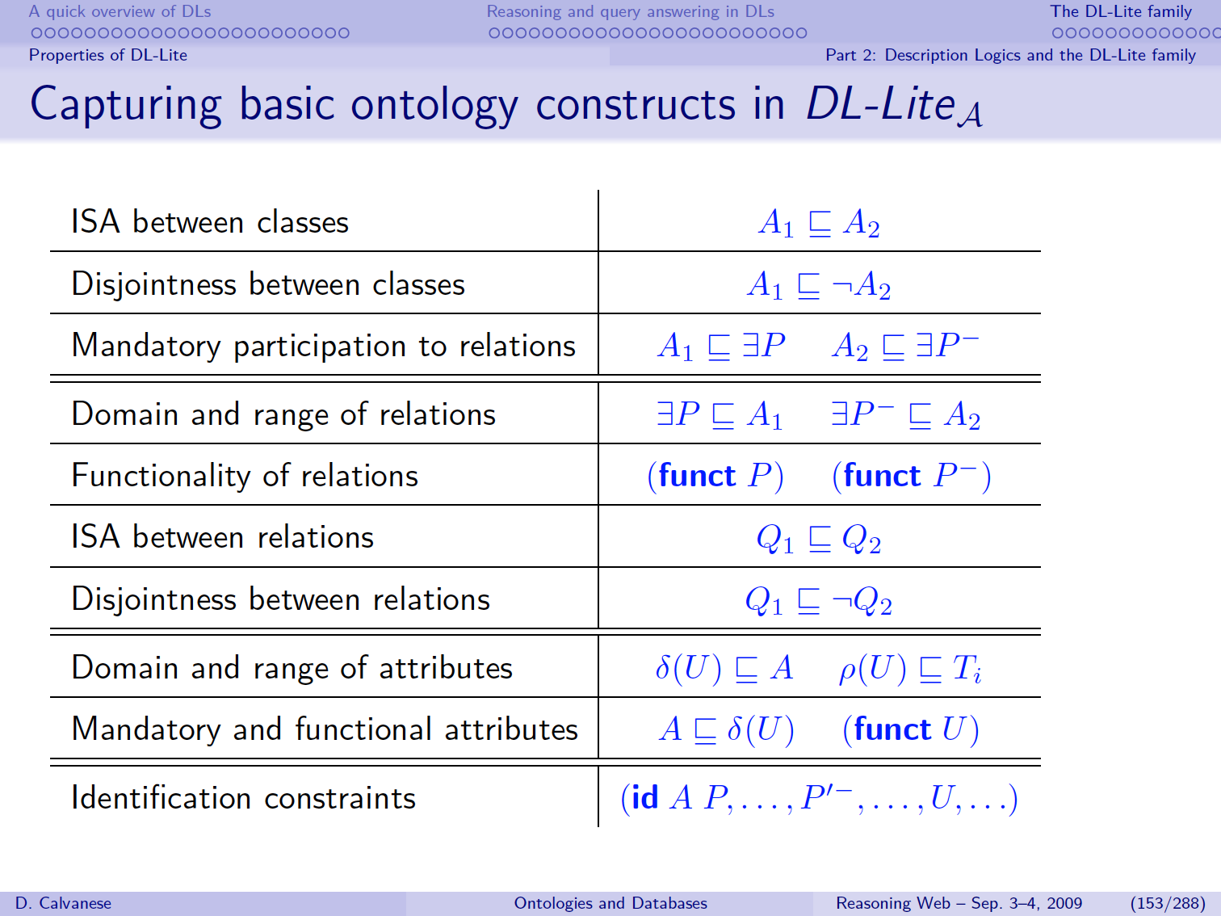

Slide 18
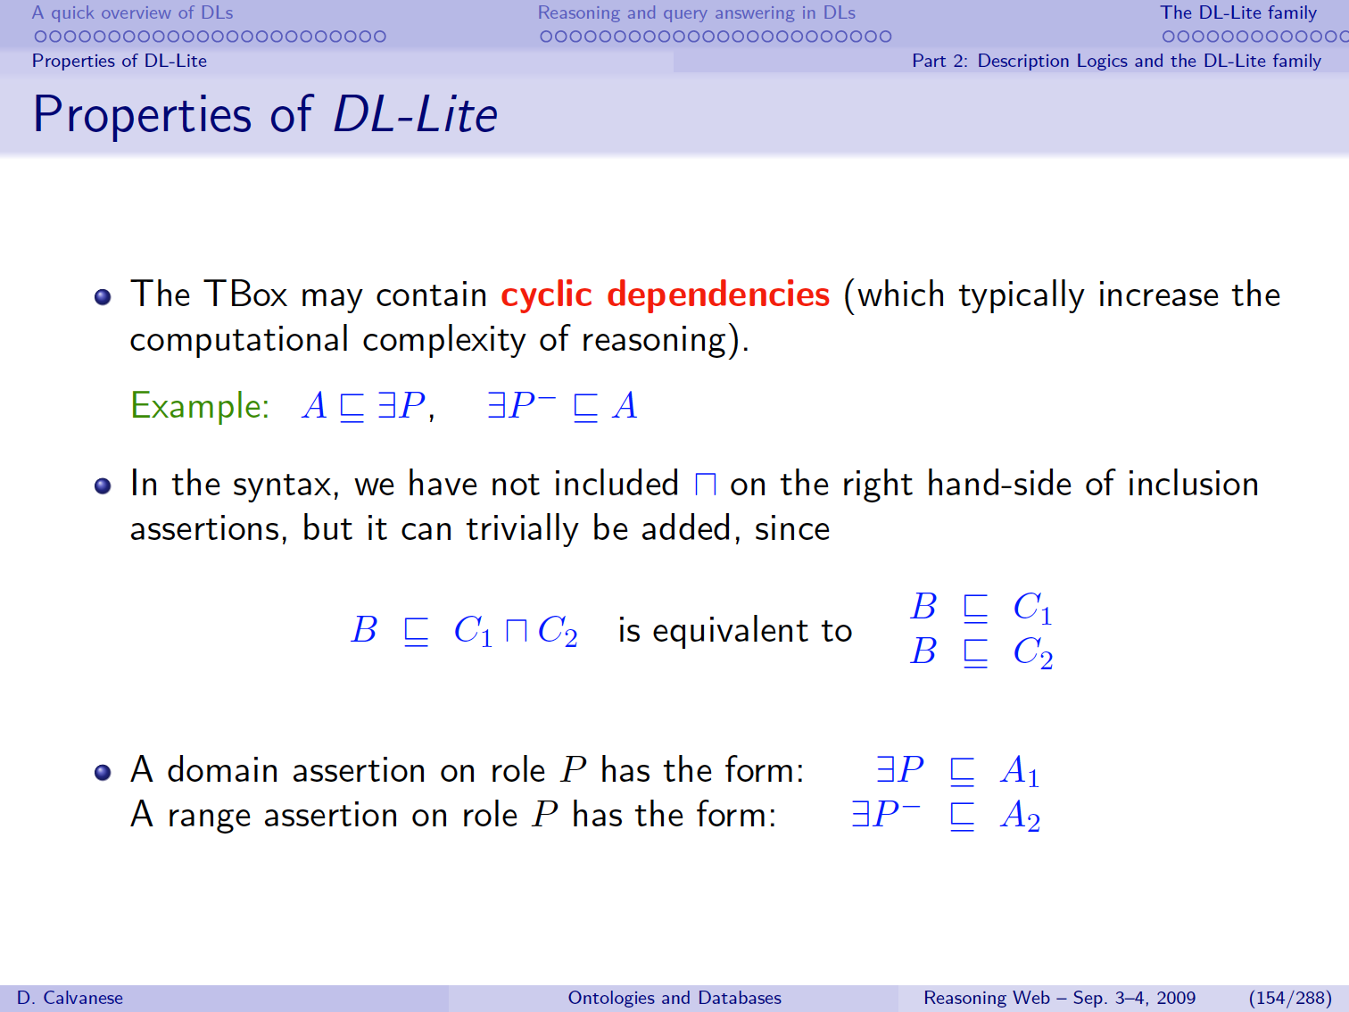
A(x) → P(x,f(x))
P(x,y) → A(y)

Slide 19
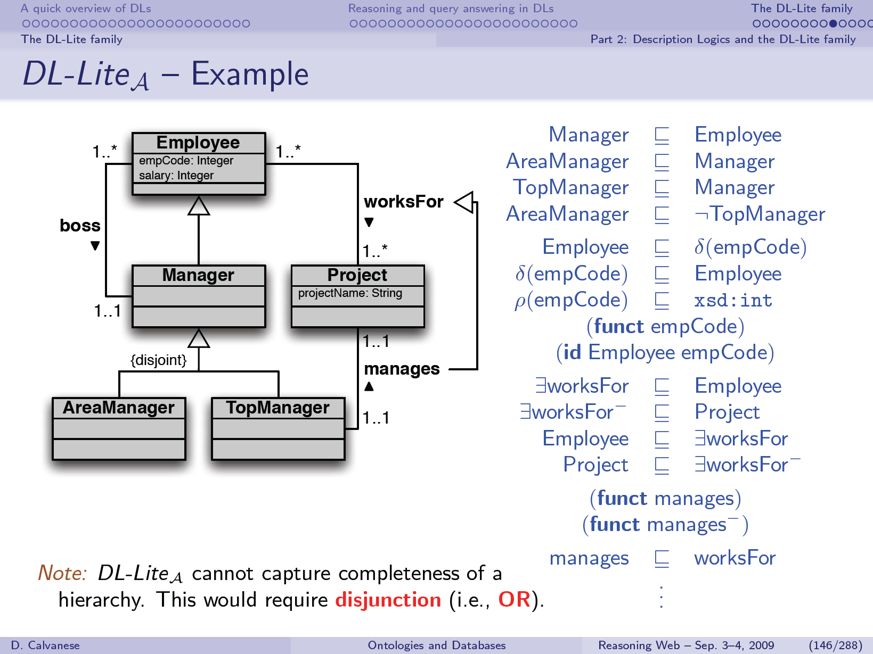

Slide 20
Encoding UML diagrams in Description Logics
[based on slide from Diego Calvanese]
Notes:
JLA: Circled what OWL2-QL cannot represent … Not too bad for a much better complexity …

Slide 21
Conjunctive Query Answering in DL-Lite
Check whether the database (ABox) is consistent
Turn negative inclusions and functionality assertions into queries that find witnesses that show a violation of the constraints
If Abox is inconsistent, stop or repair. Otherwise
Extend user query with ontology inferences
Rewrite conjunctive user query into a union of conjunctive queries by compiling ontology inferences.
Evaluate the rewritten (SQL) query over the database

Slide 22
Ontology Satisfiability
Check negative inclusions (NIs) and functionality assertions
Compute closure of Negative Inclusions
Translate to test queries over the DB
If query returns a tuple, then KB is inconsistent

Slide 23
Computing the closure of Negative Inclusions (NIs)
Take into account the interactions between
negative and positive inclusions

Slide 24
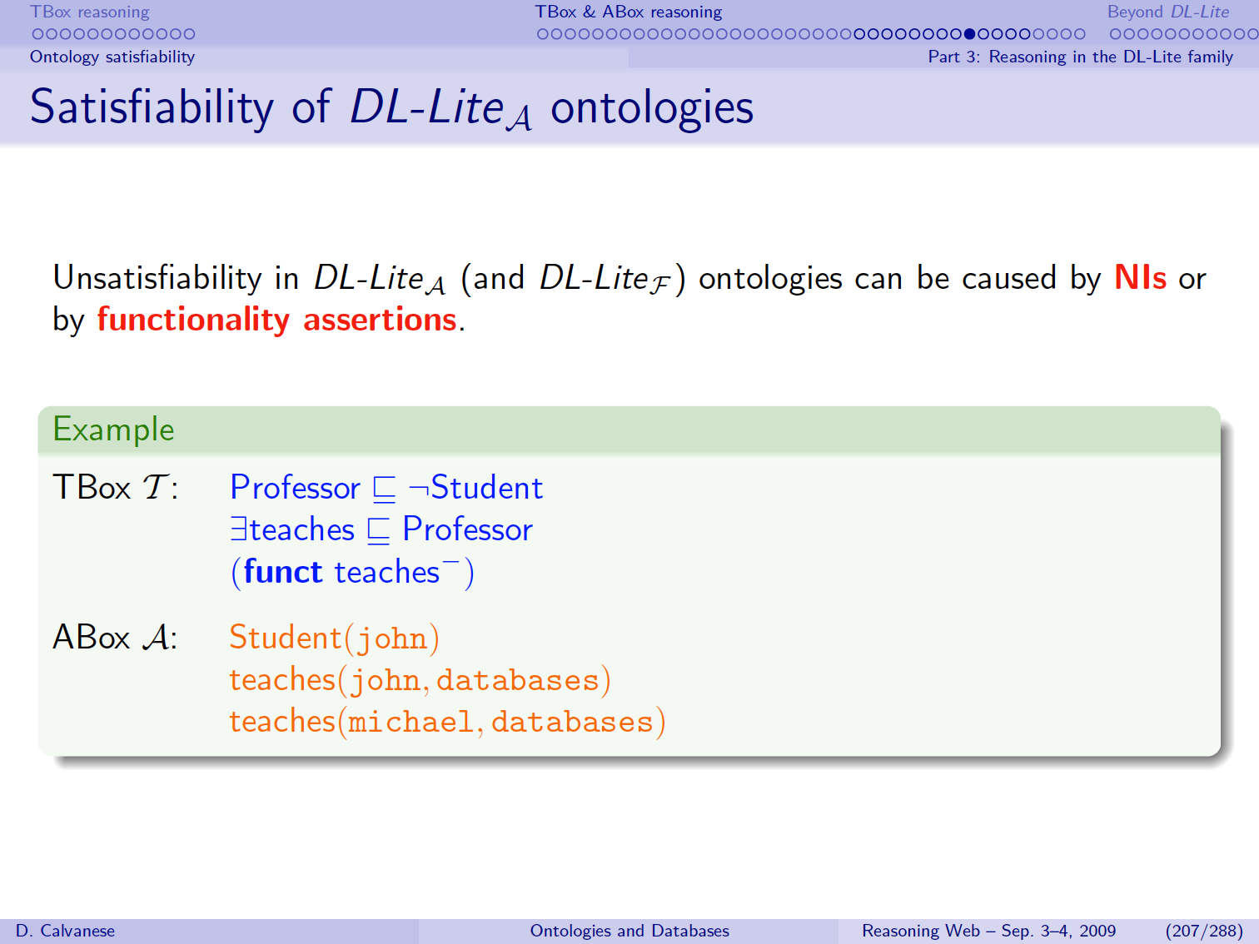
Notes:
JLA: Abox is unsatisfiable for 2 reasons:
Professors and students are disjoint. The first argument of teaches must be a professor. John is a student. But john teaches databases.
The inverse of teaches (let’s call it “is-taught-by”) is functional (single valued). That is, a course can only be taught by one professor. However databases is taught by two individuals.

Slide 25
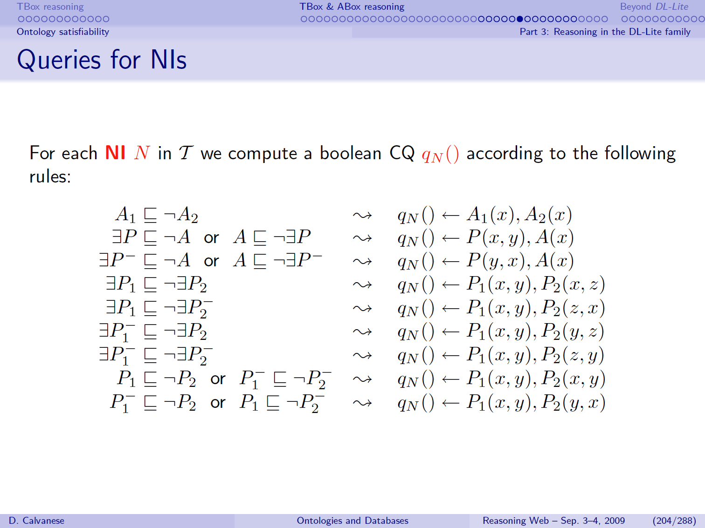
(Negative Inclusions)

Slide 26
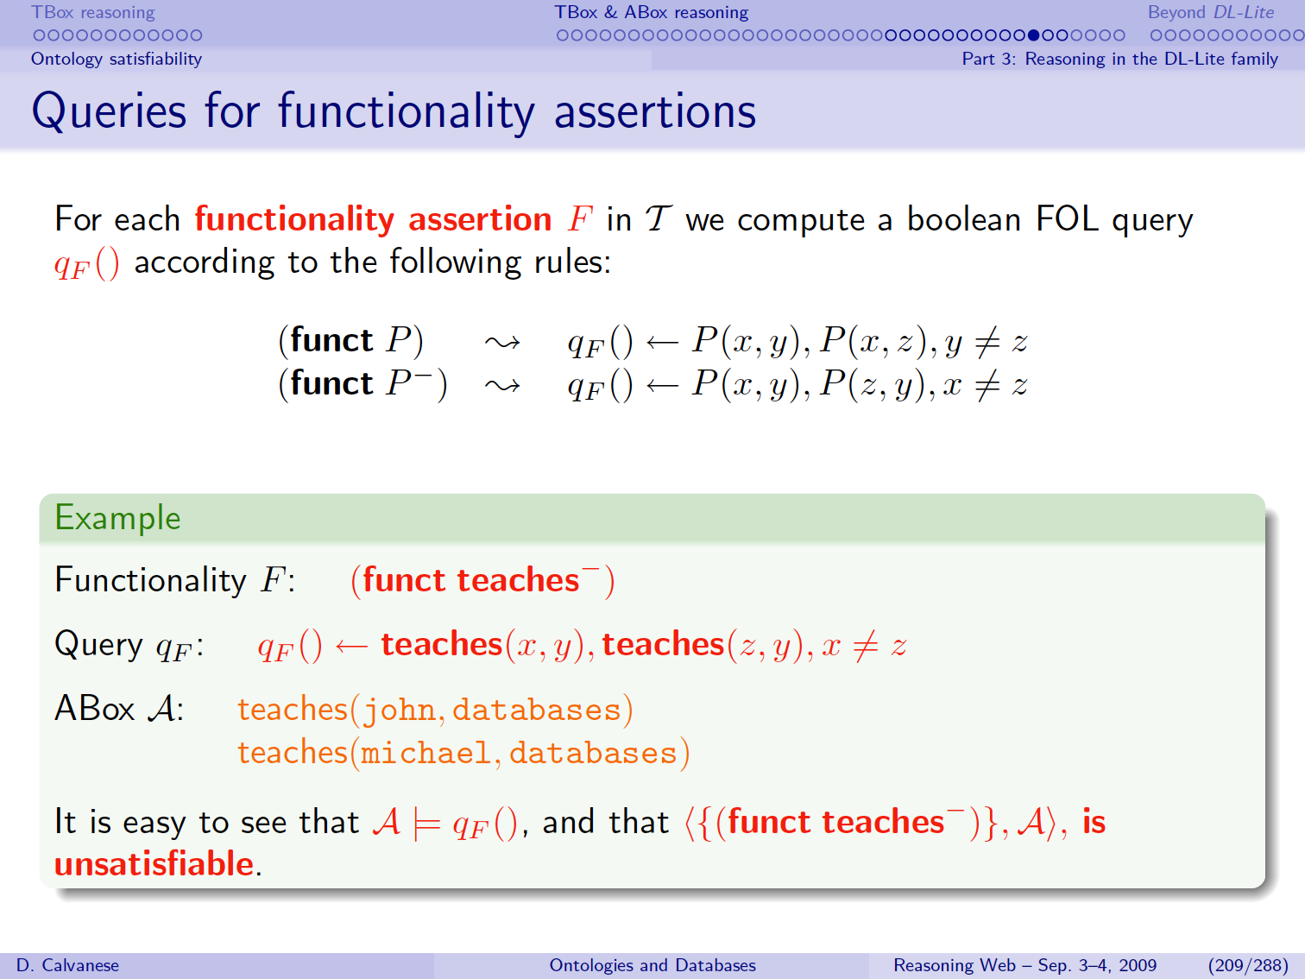

Slide 27
Ontology Satisfiability
Ontology (TBox)
Closure of
Negative Inclusions
Satisfiability Test
Queries

Slide 28
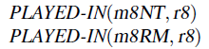
Ontology Satisfiability
Assume we add: (funct PLAYED-IN⁻)
The test query would be:
Then, the ontology would be inconsistent:

Slide 29
Query Answering
Given conjunctive query Q:
1. Compile ontology reasoning into query
Assume ontology satisfiable, consider only positive inclusions
Yields a (large) union of conjunctive queries (UCQ)
2. Evaluate the UCQ over a (relational) database

Slide 30
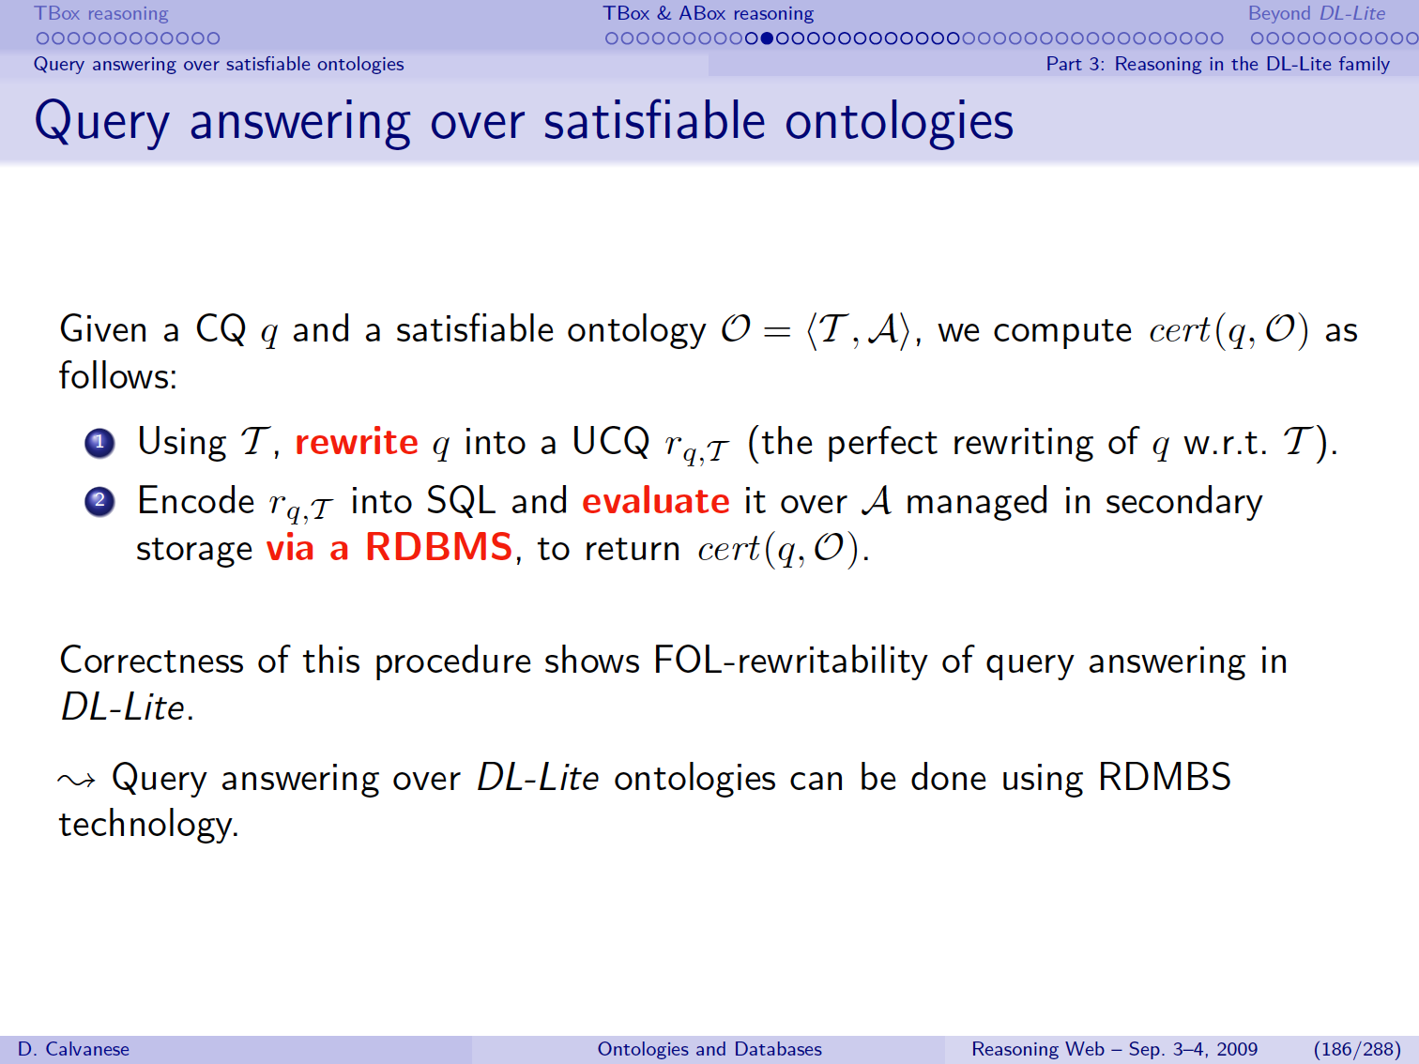

Slide 31
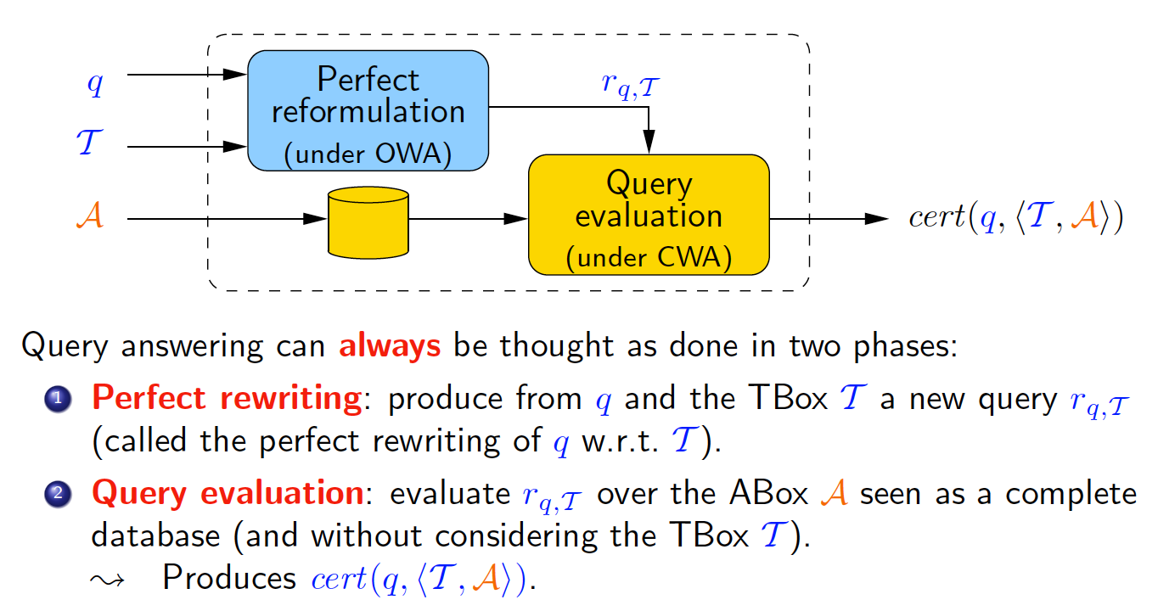
Query Rewriting
[based on slide from Diego Calvanese]

Slide 32
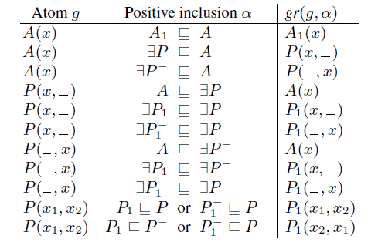
“Perfect” Reformulation
Essentially, include rule antecedents (“subclasses”) into copies of the query
A₁(x) → A(x)
…
A(x) → P(y,x)
…
P₁(x,y) → P(y,x)
[JL Ambite]

Slide 33
PerfectRef Algorithm

Slide 34
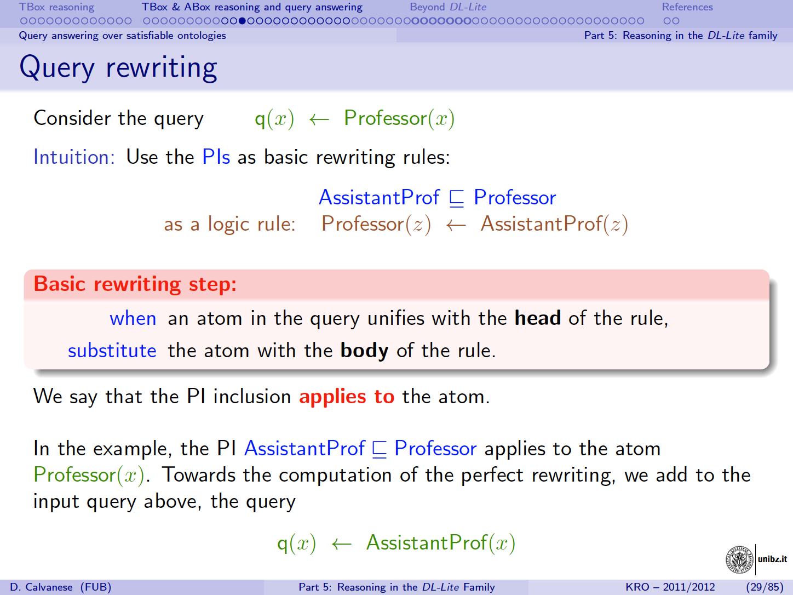
AP(z) → P(z)
consequent
antecedent

Slide 35
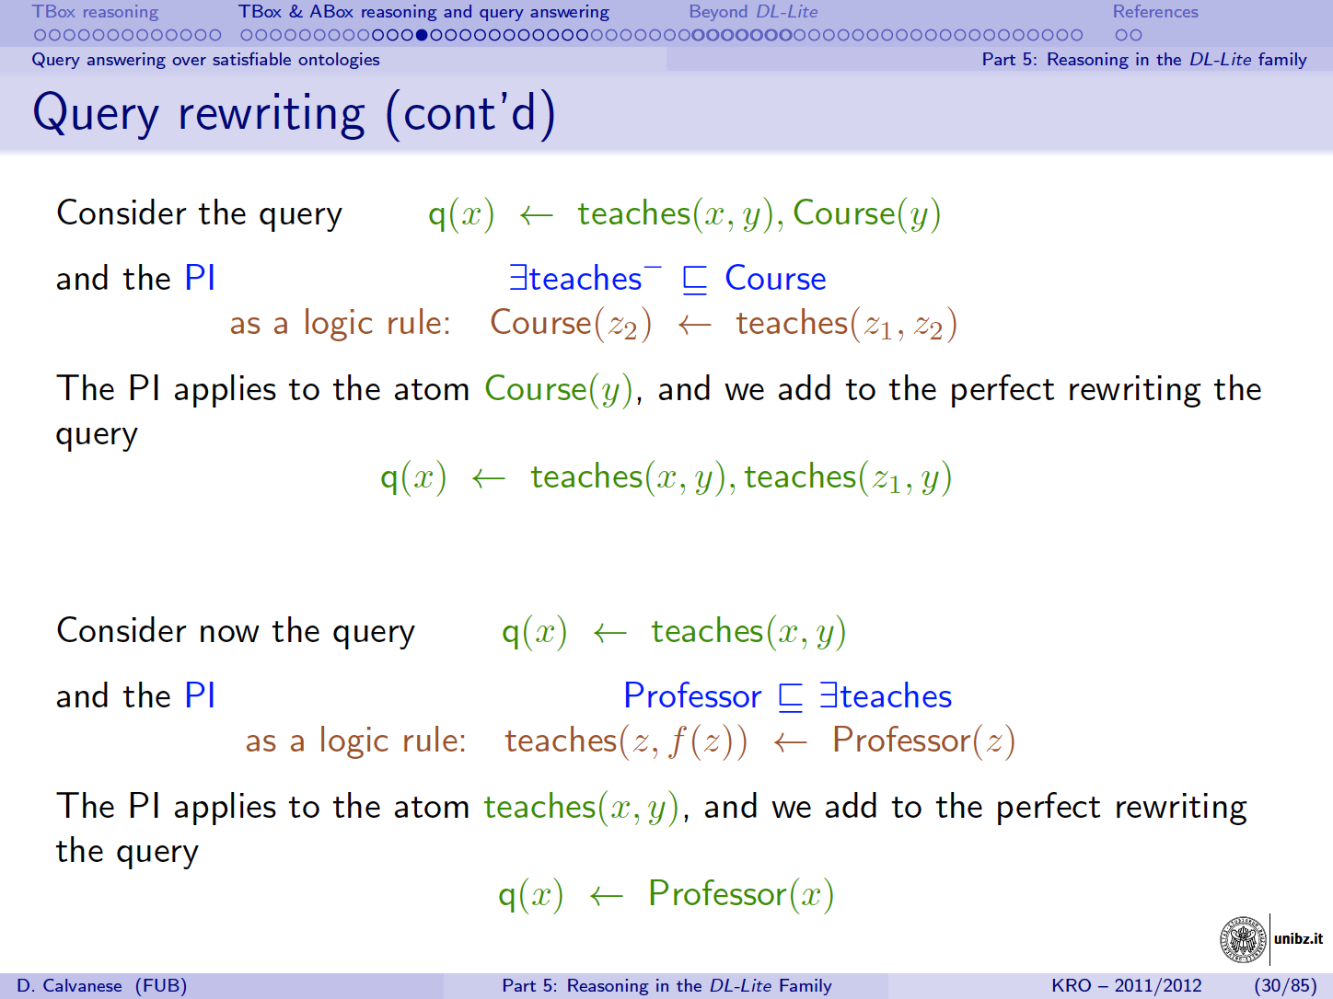
te(u,z) → C(z)

Slide 36
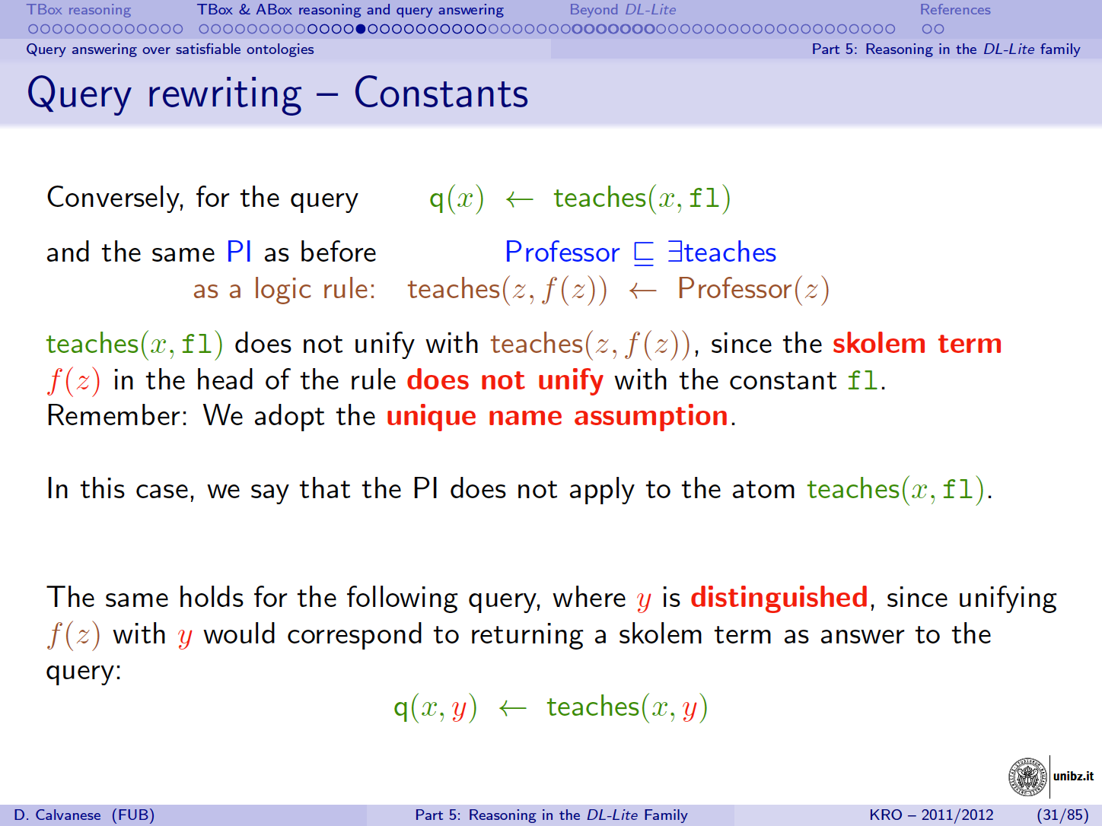
P(z) → te(z, f(z))

Slide 37
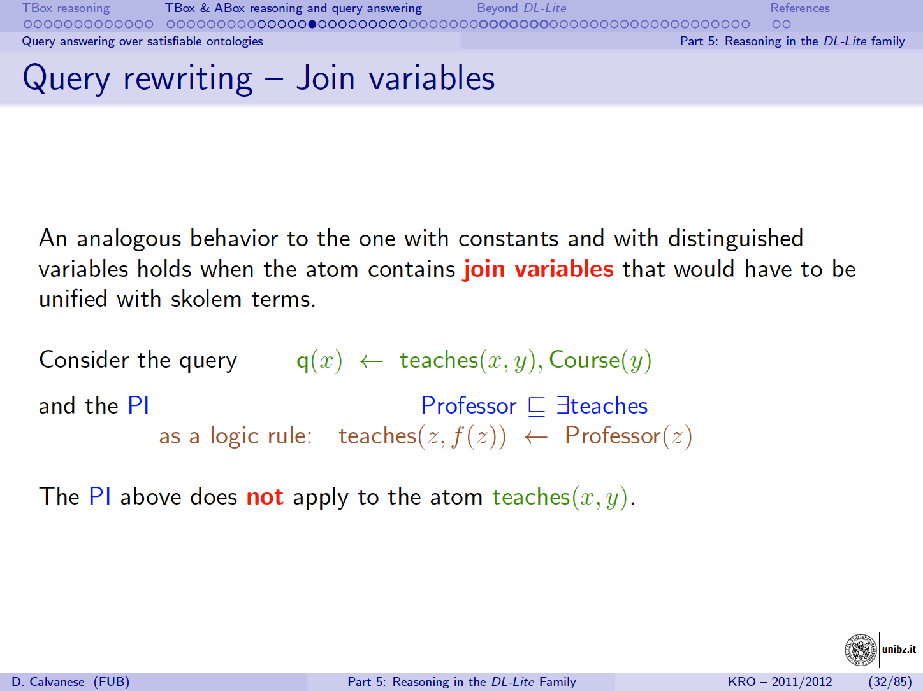
P(z) → te(z, f(z))

Slide 38
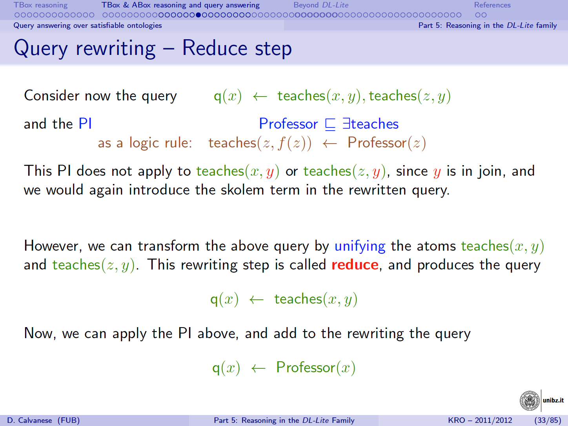
P(z) → te(z, f(z))
Notes:
q1(x) ←te(x y) ^ te(z y)
q2(x) ← te(x y)
q1 is equivalent to q2 (proof by containment mappings)

Slide 39
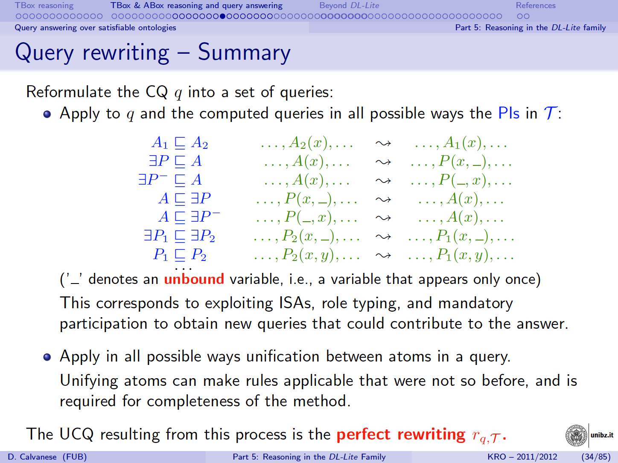

Slide 40
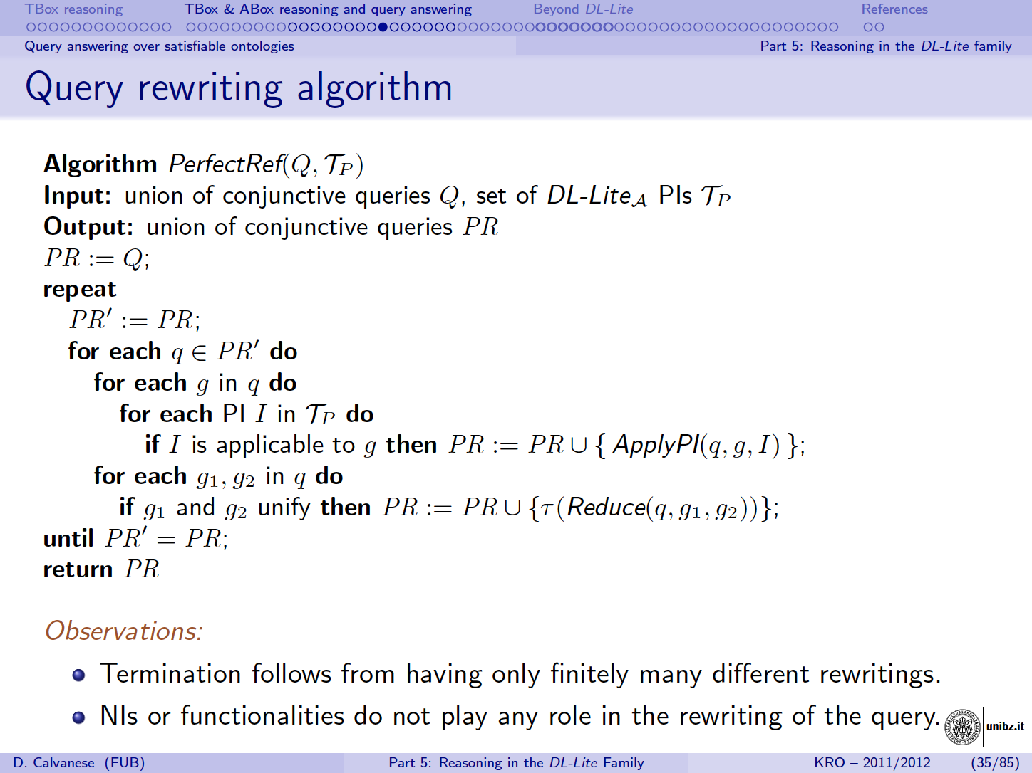

Slide 41
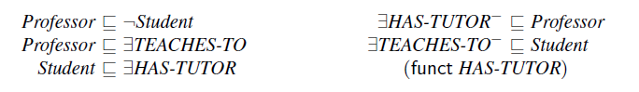
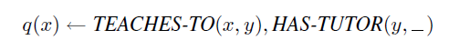
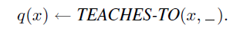
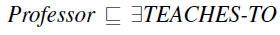
Perfect reformulation example
Ontology
User Query
1
Contained in 4
2
3
4
unification
5
6

Slide 42
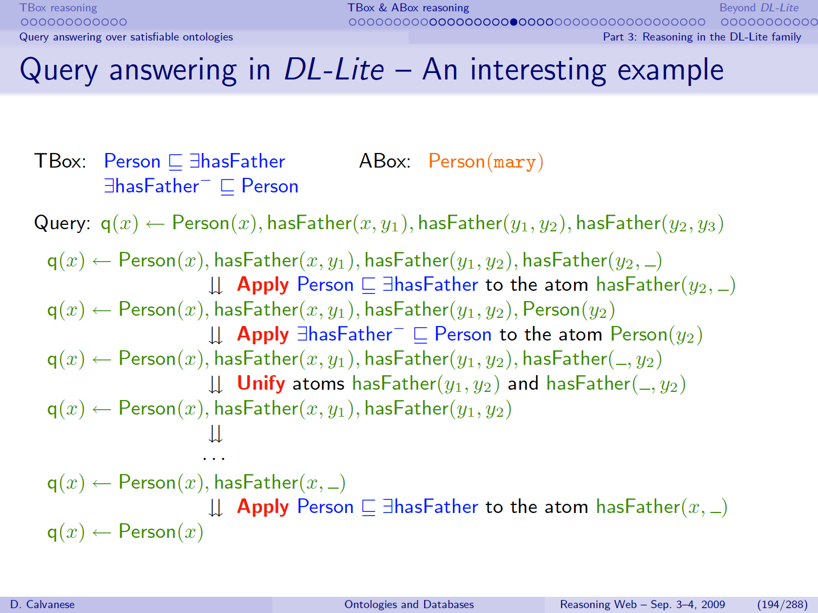
P(x) → hasFather(X Y)
hasFather(X Y) → P(Y)

Slide 43
P(x) → hasFather(X Y)
hasFather(X Y) → P(y)

Slide 44
Query Rewriting
[based on slide from Diego Calvanese]

Slide 45
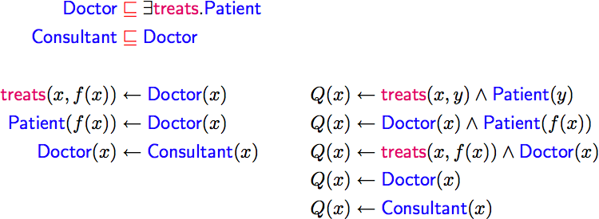
Query Rewriting Technique
Example:
[slide by Ian Horrocks]

Slide 46
Query Rewriting Technique
Example:
[slide by Ian Horrocks]

Slide 47
Query Rewriting Technique
Example:
[slide by Ian Horrocks]

Slide 48
Query Rewriting Technique
Example:
[slide by Ian Horrocks]

Slide 49
Query Rewriting Technique
Example:
[slide by Ian Horrocks]

Slide 50
Query Rewriting Technique
Example:
[slide by Ian Horrocks]

Slide 51
Query Rewriting Technique
Example:
[slide by Ian Horrocks]

Slide 52
Query Rewriting Technique
Example:
[slide by Ian Horrocks]

Slide 53
Query Rewriting Technique
Example:
[slide by Ian Horrocks]

Slide 54
Query Rewriting Technique
Example:
[slide by Ian Horrocks]

Slide 55
Query Rewriting Technique
Example:
[slide by Ian Horrocks]

Slide 56
Query Rewriting Technique
Example:
[slide by Ian Horrocks]

Slide 57
Query Rewriting Technique
Example:
For DL-Lite, result is a union of conjunctive queries
[slide by Ian Horrocks]

Slide 58

Query Rewriting Technique
Data can be stored/left in RDBMS
Relationship between ontology and DB defined by mappings, e.g.:
UCQ translated into SQL query:
[slide by Ian Horrocks]

Slide 59
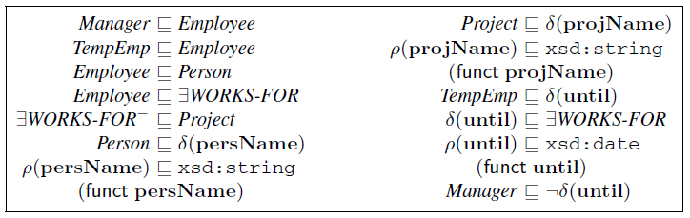
Accessing Data Through Ontologies
[Poggi et al., 2008]
Schema Mappings:
Aux1(s,p,d)
Aux2(s,n)
Aux3(s,n)
Aux4(c,n)

Slide 60
domain-level user query
domain-level expanded query
Perfect reformulation
schema mappings
source-level query
query
rewriting

Slide 61
Complexity for extensions of DL-Lite_{A, id}
Ontologies and Databases: The DL-Lite Approach
Diego Calvanese, Giuseppe De Giacomo, Domenico Lembo, Maurizio Lenzerini,
Antonella Poggi, Mariano Rodriguez-Muro, and Riccardo Rosati

Slide 62
OWL2 EL
Franz Baader, Sebastian Brandt, and Carsten Lutz. Pushing the EL Envelope. In Proc. of the 19th Joint Int. Conf. on Artificial Intelligence (IJCAI 2005), 2005
Franz Baader, Sebastian Brandt, and Carsten Lutz. Pushing the EL Envelope Further. In Proc. of the Washington DC workshop on OWL: Experiences and Directions (OWLED08DC), 2008

Slide 63
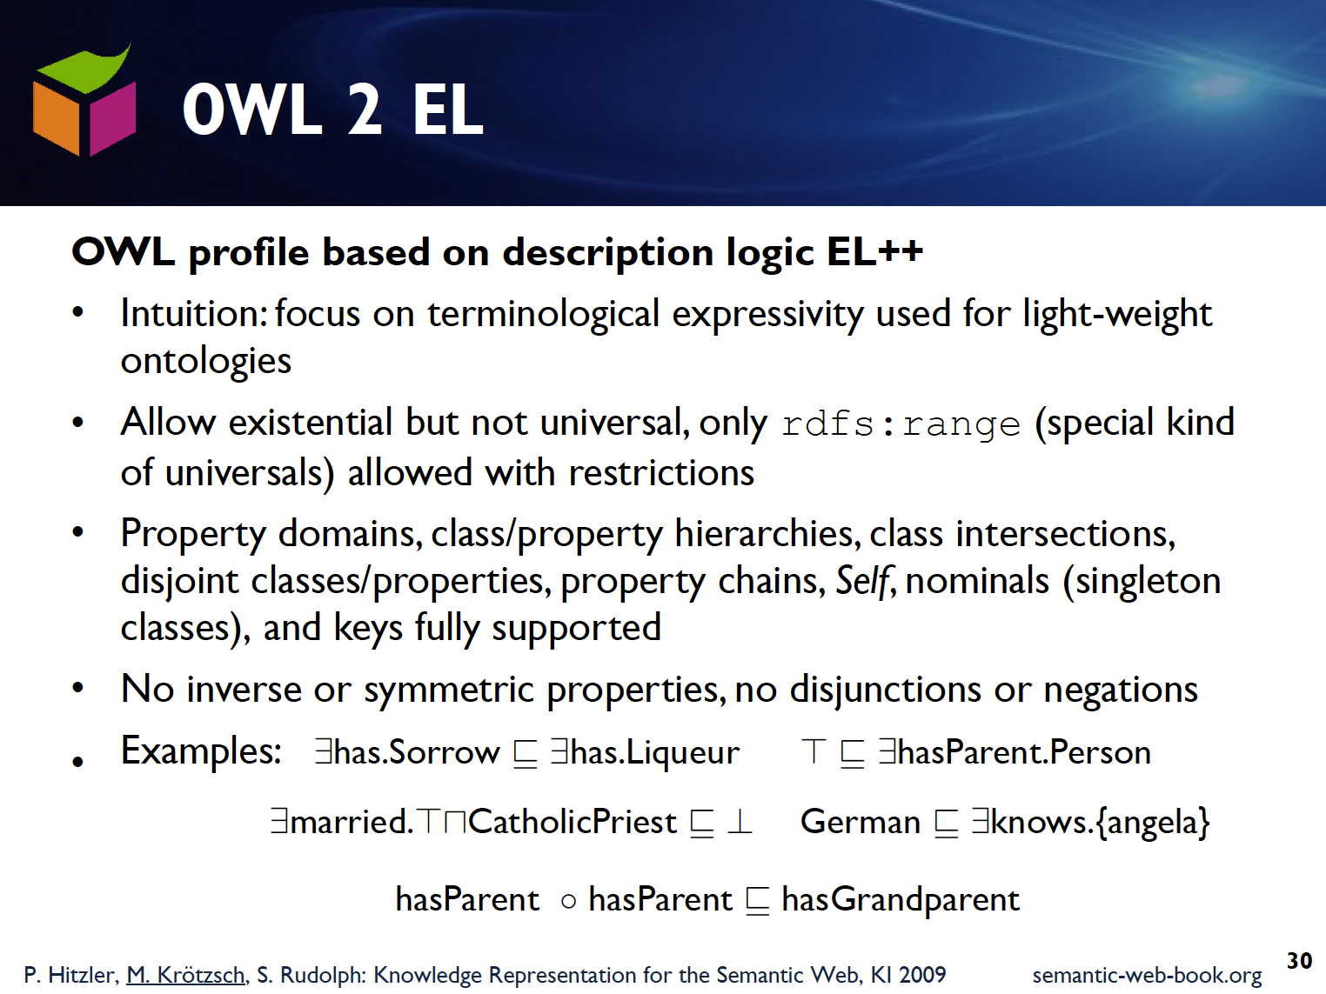
restricted

Slide 64
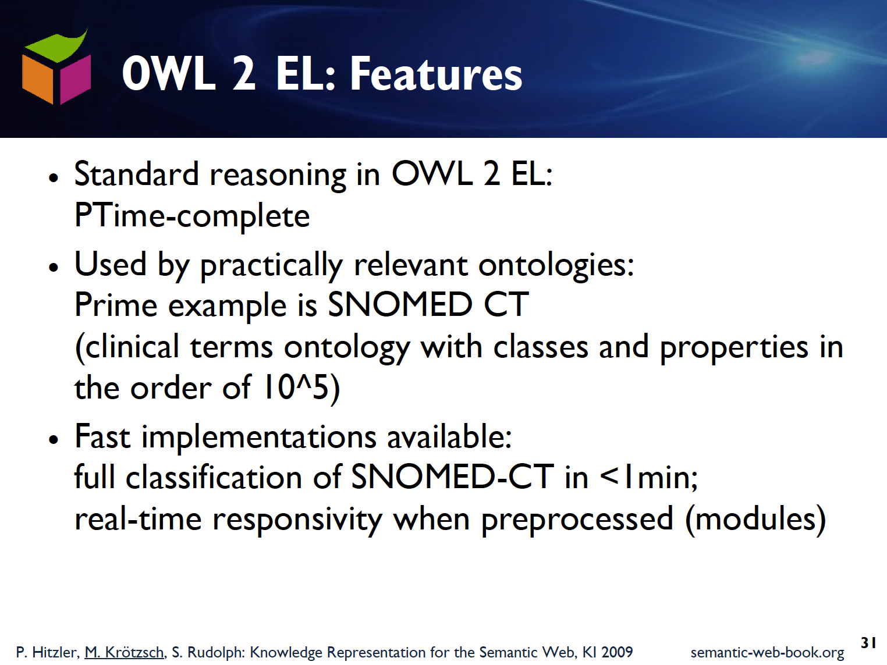

Slide 65
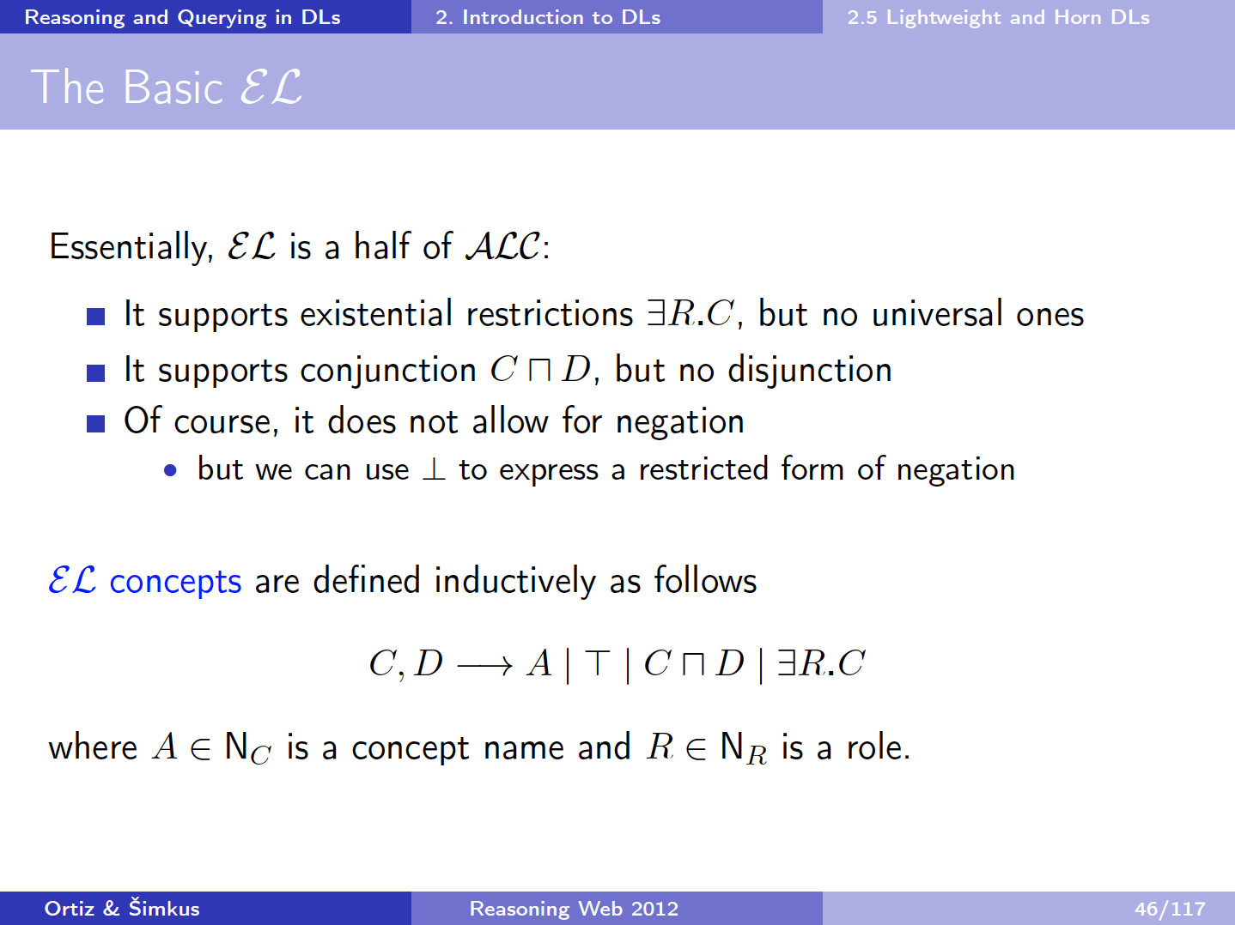

Slide 66
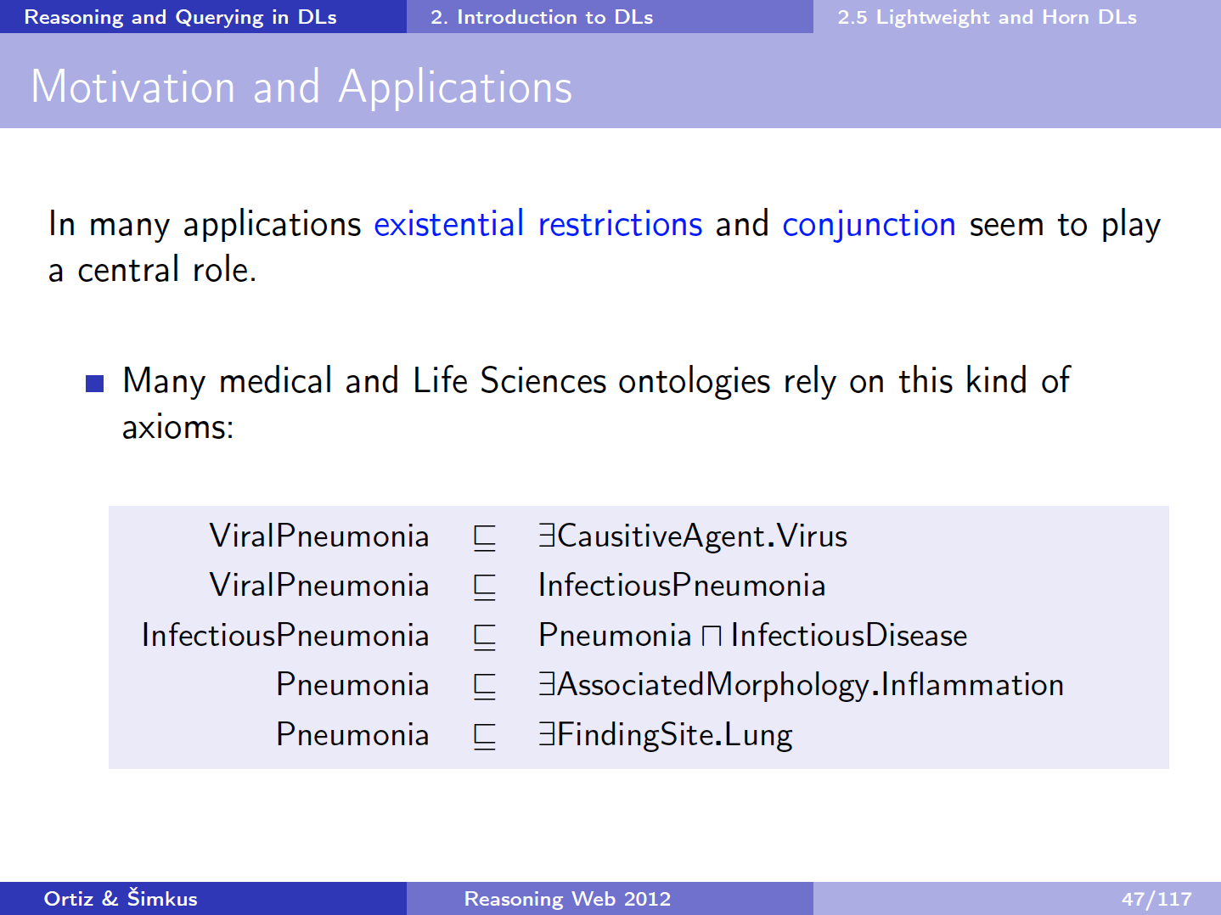

Slide 67
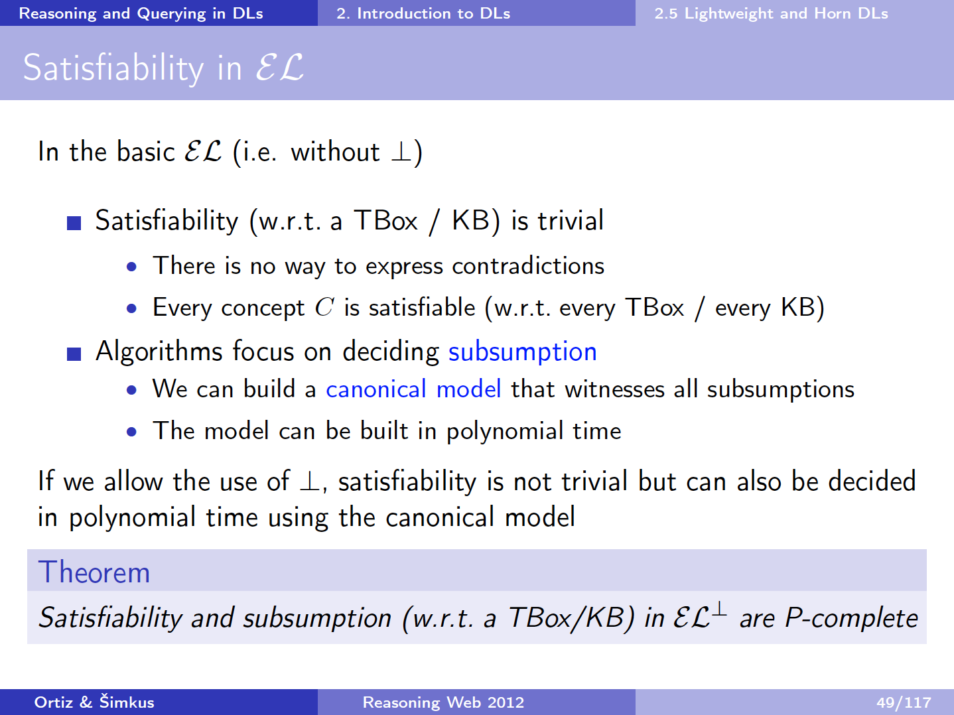

Slide 68
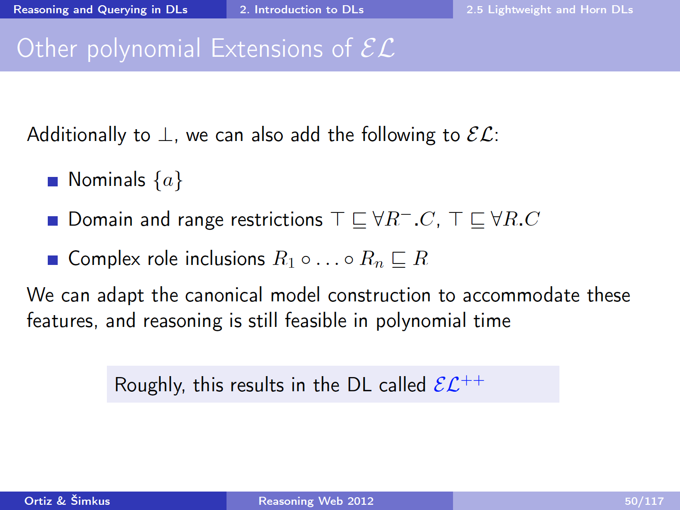
dom(R)
∃R ⊑ C
ran(R)
∃R⁻ ⊑ C

Slide 69
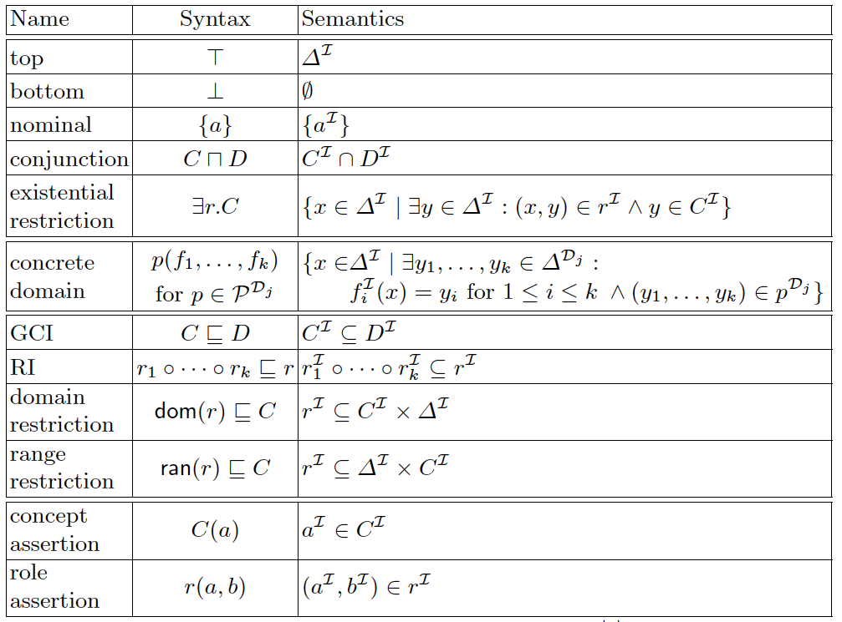
EL++: Syntax and Semantics

Slide 70
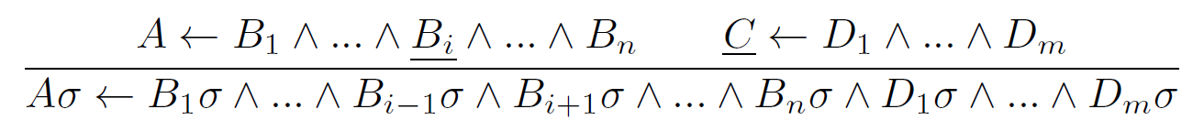
REQUIEM
Query reformulation over an expressive description logic:
Includes DL-Lite+, DL-Lite_{R} , and
Recursive queries and recursive rewritings → polynomial data complexity
Based on resolution:

Slide 71
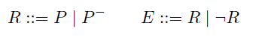
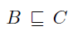
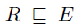

Slide 72
Translation to Horn Clauses

Slide 73
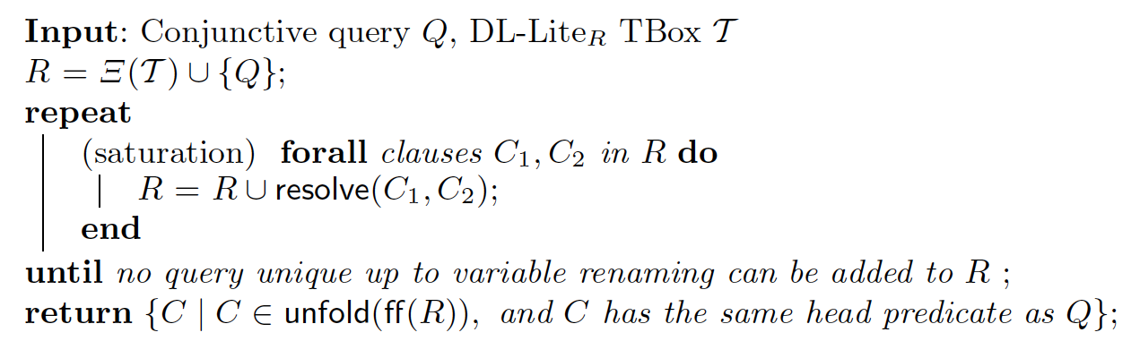
REQUIEM: Resolution-based query rewriting
Resolution Rule:

Slide 74
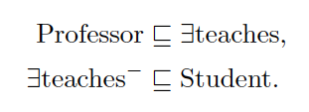
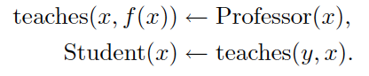
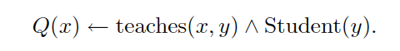
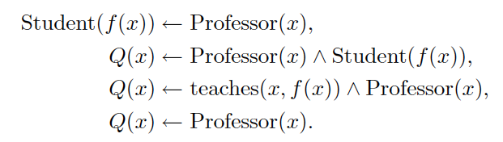
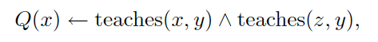
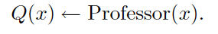
REQUIEM: Example Rewriting
Ontology:
Clauses:
Query:
Resolutions:
Rewriting:
[ Pérez-Urbina et al, ISWC 2009]

Slide 75
Requiem Example (cont)
Saturation:
(1) q(x) ← t(x,y) ^ s(y)
(2) t(x1, f(x1)) ← p(x1)
(3) s(x2) ← t(y2,x2)
(4 = 1,2) q(x) ← p(x) ^ s(f(x))
(5 = 1,3) q(x) ← t(x, y) ^ t(y2,y)
(6 = 2,3) s(f(x1)) ← p(x1)
(7 = 4,6) q(x) ← p(x) ^ p(x)
(7 –dup) q(x) ← p(x)
(8 = 1,6) q(x) ← t(x,f(x1)) ^ p(x1)
After removing q clauses with function symbols:
(1) q(x) ← t(x,y) ^ s(y)
(5) q(x) ← t(x, y) ^ t(y2,y)
(7) q(x) ← p(x)

Slide 76
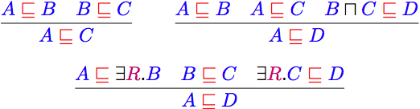
Saturation-based Technique
Normalise ontology axioms to standard form:
Saturate using inference rules:
Extension to Horn fragment requires (many) more rules
[slide by Ian Horrocks]

Slide 77

Saturation-based Technique
Example:
[slide by Ian Horrocks]

Slide 78
Saturation-based Technique
Example:
[slide by Ian Horrocks]

Slide 79
Saturation-based Technique
Example:
[slide by Ian Horrocks]

Slide 80
Saturation-based Technique
Example:
[slide by Ian Horrocks]

Slide 81
Saturation-based Technique
Example:
[slide by Ian Horrocks]

Slide 82
Saturation-based Technique
Example:
[slide by Ian Horrocks]

Slide 83
Saturation-based Technique
Example:
[slide by Ian Horrocks]

Slide 84
Saturation-based Technique
Example:
[slide by Ian Horrocks]

Slide 85
Saturation-based Technique
Example:
[slide by Ian Horrocks]

Slide 86

Saturation-based Technique
Example:
[slide by Ian Horrocks]

Slide 87
Saturation-based Technique
Example:
[slide by Ian Horrocks]

Slide 88
Saturation-based Technique
Example:
[slide by Ian Horrocks]

Slide 89

Saturation-based Technique
Performance with large bio-medical ontologies:
[slide by Ian Horrocks]

Slide 90
OWL2 RL
Based on Description Logic Programms (DLP)
Intersection of OWL2 and Horn Rules
Can be implemented using standard rule engines
No existentials or union, in consequent (RHS)
No negation or universals, in antecedent (LHS)
Can provide correctness guarantees
For conformant ontologies and atomic queries
In other cases results may be incomplete
Benjamin N. Grosof, Ian Horrocks, Raphael Volz, and Stefan Decker. Description Logic Programs: Combining Logic Programs with Description Logic. in Proc. of the 12th Int. World Wide Web Conference (WWW 2003), Budapest, Hungary, 2003. pp.: 48–57

Slide 91


Slide 92


Slide 93
OWL2 RL
Subclass Expressions | Superclass Expressions
a class other than owl:Thing an enumeration of individuals (ObjectOneOf) intersection of class expressions (ObjectIntersectionOf) union of class expressions (ObjectUnionOf) existential quantification to a class expression (ObjectSomeValuesFrom) existential quantification to a data range (DataSomeValuesFrom) existential quantification to an individual (ObjectHasValue) existential quantification to a literal (DataHasValue) | a class other than owl:Thing intersection of classes (ObjectIntersectionOf) negation (ObjectComplementOf) universal quantification to a class expression (ObjectAllValuesFrom) existential quantification to an individual (ObjectHasValue) at-most 0/1 cardinality restriction to a class universal quantification to a data range (DataAllValuesFrom) existential quantification to a literal (DataHasValue) at-most 0/1 cardinality restriction to a data range (DataMaxCardinality 0/1)

Slide 94
RDFS and Horn Logic
Triple(a,P,b) P(a,b)
a rdf:type C C(a)
C subClassOf D C(X) → D(X)
P subPropertyOf Q P(X,Y) → Q(X,Y)
domain(P,C) P(X,Y) → C(X)
range(P,C) P(X,Y) → C(Y)

Slide 95
OWL2 in Horn Logic (1)
OWL | Horn Rules
C sameClassAs D | C(X) → D(X) D(X) → C(X)
P samePropertyAs Q | P(X,Y) → Q(X,Y) Q(X,Y) → P(X,Y)
(C1 ∩ C2) subClassOf D | C1(X), C2(X) → D(X)
C subClassOf (D1 ∩ D2) | C(X) → D1(X) C(X) → D2(X)
(C1∪ C2) subClassOf D | C1(X) → D(X) C2(X) → D(X)
C subClassOf (D1 ∪ D2) | Not allowed
C subClassOf allValuesFrom(P,D) | C(X), P(X,Y) → D(Y)
allValuesFrom(P,D) subClassOf C | Not allowed
C subClassOf SomeValuesFrom(P,D) | Not allowed
SomeValuesFrom(P,D) subClassOf C | D(Y), P(X,Y) → C(X)

Slide 96
OWL2 in Horn Logic (2)
OWL | Horn Rules
transitiveProperty(P) | P(X,Y), P(Y,Z) → P(X,Z)
inverseProperty(P,Q) | Q(X,Y) → P(Y,X) P(X,Y) → Q(Y,X)
functionalProperty(P) | P(X,Y), P(X,Z) → Y=Z
minCardinality | Cannot be translated
MaxCardinality 1 P C | P(X,Y), P(X,Z), C(X), C(Y) → Y=Z
…

Slide 97

Rules for OWL RL (DLP)
There are many rules
This is only one of 9 tables, most of which are much larger
http://www.w3.org/TR/owl2-profiles#Reasoning_in_OWL_2_RL_and_RDF_Graphs_using_Rules
[slide by Ian Horrocks]

Slide 98

OWL2 Profiles: Comparison of Core Constructs
OWL RL and QL allow inverse properties, EL doesn't.
x: supported construct
(x): could be supported without increasing complexity
Axioms of form: CL ⊑ CR (and also )
[See Markus Krötzsch: http://korrekt.org/page/OWL_2_Profiles ]

Slide 99
OWL2 Profiles
OWL 2 defines three different tractable profiles:
QL: very fast (AC₀) query answering using RDBMs (SQL)
Useful for large datasets (stored in RDBs)
EL: fast (P) reasoning for schema and data
Useful for ontologies with large conceptual part
Ex: biomedical ontologies, O(10⁵) concepts
RL: fast (P) query answering using rule-extended DBs
Useful for large datasets stored as RDF triples
[based on slide from Ian Horrocks]

